Slide 1
Govern your cloud platform
Jermila Paul Dhas

Slide 2
Notes:
The Financial Times first moved to AWS in 2013. We started with one large account shared by dozens of teams. While this gave us loads of benefits, we quickly found that there were lots of security problems we didn’t really consider with single account architecture.
Our tech directors were really frustrated because it became very hard to keep track of incidents.
But today we have small, clean accounts - so this talk is going to be about how we managed to turn it around?
I am going to talk a bit about our journey from moving away from datacenters to using AWS
Problems we faced with a single large shared account
And the motivations to move from a single account to multiple accounts
And how we made sure the AWS resources were compliant to FT standards

Slide 3
Who am I?
Notes:
Hi. I am Jermila Dhas. I am a senior engineer at the Financial Times and I am a huge fan of Disney’s Frozen, musical theatre, a good steak steak and kpop.
Currently I work in a team who support and maintain backend Content API’s, working with AWS, kubernetes, docker and Go microservices.

Slide 4
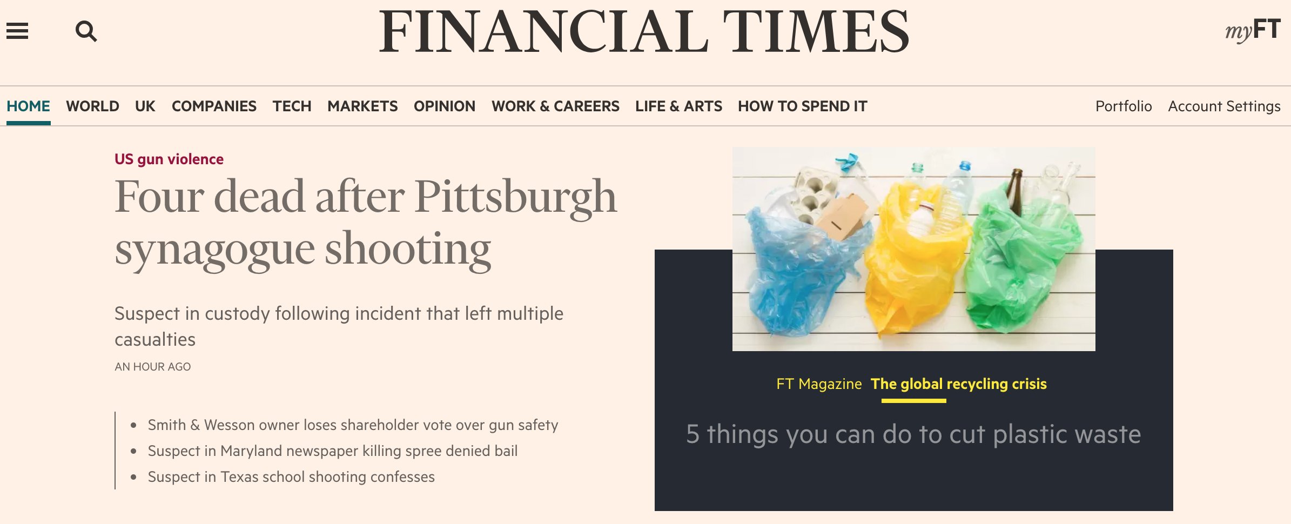
Notes:
We are one of the world’s leading business news organisations. The FT has been around for a 130 years with a record paying readership of more than 930,000, three-quarters of which are digital subscriptions.
As a news organization, content and the website are really critical to our business. The FT believes in investing a lot in technology and empower teams to make technological decisions. So if you really want to work in an environment like that,

Slide 5
We're hiring!
https://ft.com/dev/null
Notes:
we currently have some open positions. please have a look - and feel free to and come chat to me afterwards.
So moving onto the fun stuff.
So how did it all start?

Slide 6
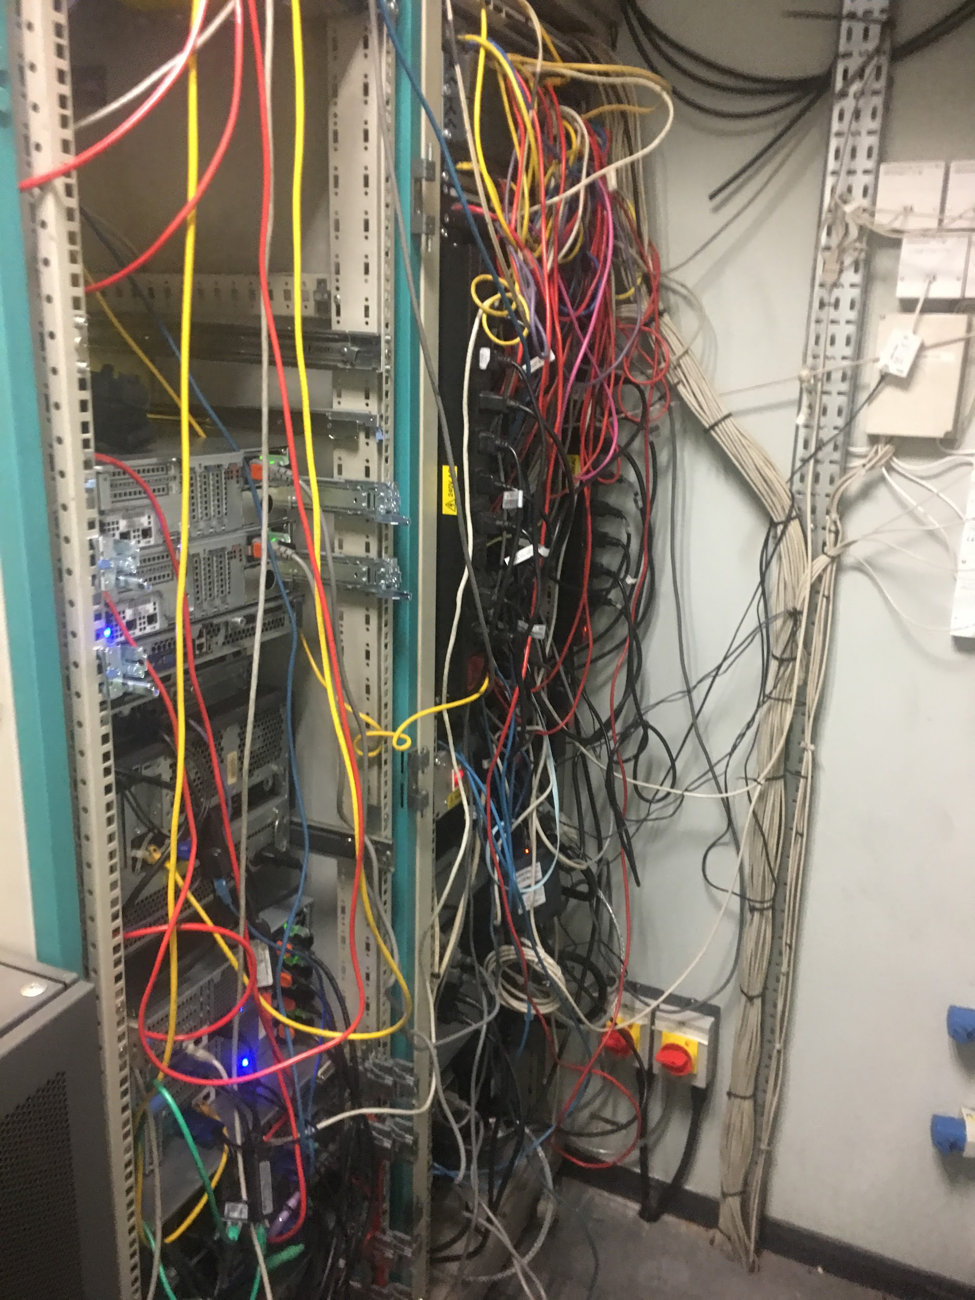
2011
Notes:
It was 2011. Back in the days, we had that. This is a picture of our datacenter. We were not really a big fan of it at all. IT was occupying space. it costed us a lot of money interms of support, maintenance and operations.

Slide 7
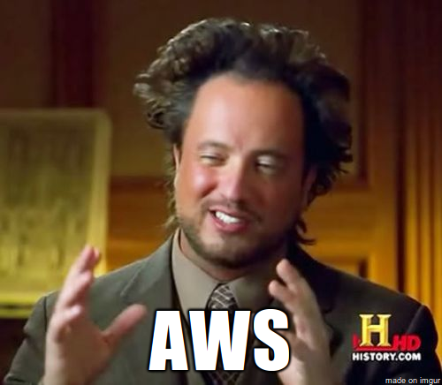
2012
Notes:
So in 2012 we started talking about AWS and we were really passionate about it. So we thought we’d give it a go.Why did we do that?

Slide 8
Cut down IT Infrastructure
Notes:
One of the concerns that we have had is that it is very expensive. we are spending a lot of money in terms of maintenance for our datacenters.
We thought if we switch to AWS, we can utilize its on-demand cloud computing platform and if we start using its pay-per-use feature which could save us operation and maintenance costs.

Slide 9
It’s not okay to grow slow!
Notes:
We didn’t like the traditional way of purchasing and keeping additional servers and storage for unexpected growth. It wasn’t working for a lot of delivery teams because we had to rely of a different team to set things up for us.

Slide 10
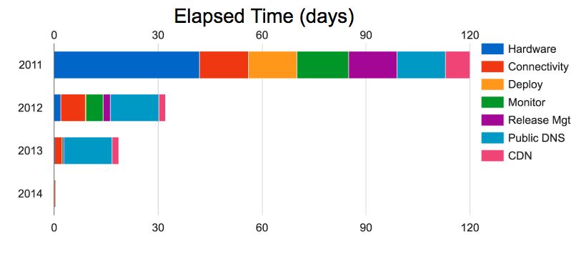
Notes:
This graph describes how long it took to roll a service to production in 2011 when we relied on our datacentres vs 2012, 2013 & 2014, which is when we started adopting AWS.
As you can see it took us 120 days to roll a service to production in 2011. About 40 days were spent on setting up hardware.
We wanted to move to AWS because one would have the power to create resources and one can scale resources up and down based on business, application and service needs.
We started using AWS quite heavily in 2013. And in 2014 it just took a couple of hours.
We really liked it.

Slide 11
Flexibility to experiment
Notes:
Moving to AWS will also enable our teams to experiment with evolving methodologies such as microservices. So good things right?

Slide 12
There is no such thing as too much security :)
Notes:
Finally, With AWS, we’d get double layered protection where the first layer of security offered by AWS and the second layer of security architecture was customised by us.
was an Added bonus

Slide 13
2013
Notes:
In 2013, we got ourselves a single AWS account that was shared by more than 30 teams in FT.

Slide 14
One year later……….
Notes:
After just one year

Slide 15
700+ EC2 instances
> 250TB of data in S3
300+ users
300+ IAM users
Notes:
We ended up having
More than 700 EC2 instances running. It was really hard to track who owned what.
More than 250 TB of data stored in S3 (We had a lot of data on S3), costing us money. With no clear ownership
300 users accessing the account
More than 300 access keys with wider permissions running amok

Slide 16
A Tale of Losing
Production
Notes:
Also, we lost one teams production clusters. Just for a very short time. But we nearly lost a lot more
Our alerts went off and we realized that a we lost one of Content’s production cluster in EU
Fortunately the ansible playbook that was doing all the deleting was targeting instances that was tagged with a specific team tag. If it weren’t for the tag, we would have lost a lot of instances in EU.
That’s when we realized the shared account set up was not really working for us. There were way too many risks.

Slide 17
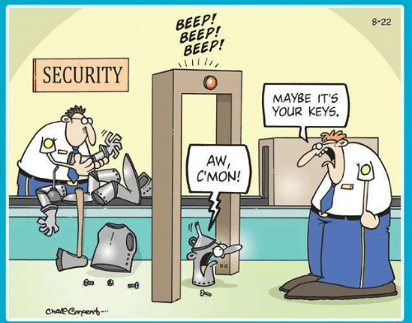
Notes:
The first and foremost risk being Security.
We thought
It would be good if we could reduce the blast radius in event of a security breach by having fewer resources, fewer access key and fewer users.
Give least privileged access to data and resources

Slide 18
Notes:
Money was still a concern for us. We really wanted clearer ownership of resources and better cost attribution.

Slide 19
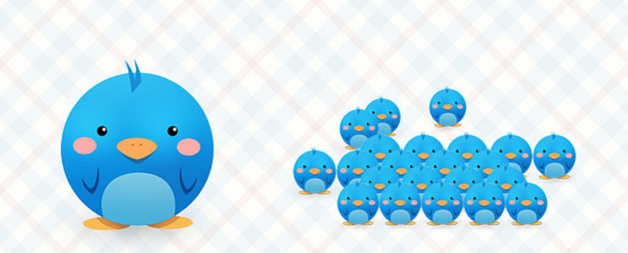
Notes:
So in 2014, we moved from a single shared account architecture to a multiple account architecture.

Slide 20
Now……….
Notes:
Today we have 600+ workloads running across 50+ AWS accounts.
Our delivery teams were very excited. We gave delivery teams flexibility to do what they want to do but we realized that costs and security were not a major concern for them!
They cared more about getting things done.
So we implemented a few rules to make sure the resources created comply to certain restrictions.
We started with…..

Slide 21
Security
Notes:
Security!

Slide 22
Least privileged access to Accounts
Notes:
We started by restricting access to AWS accounts based on AD groups using Saml.

Slide 23
Notes:
The way it works is, we have AD groups for teams.
Lets say I am trying to login to the AWS account that my team has access to.
I am going to browse to the AD FS site. ADFS is active directory federation service. It is a microsoft software that provides single sign on access to systems
The sign in page would authenticate me against AD by asking me for my AD credentials
Then my browser would receive a saml assertion in the form on an authentication response from ADFS
Then my browser would post the saml assertion to the AWS sign in endpoint to request for temporary security credentials and a sign in link
My browser would receive the signin like and redirect me to the management console.
Now that we have restricted access to AWS accounts,
https://aws.amazon.com/blogs/security/how-to-establish-federated-access-to-your-aws-resources-by-using-active-directory-user-attributes/
https://sites.google.com/a/ft.com/security/technology/authentication/awslogin-s3o

Slide 24
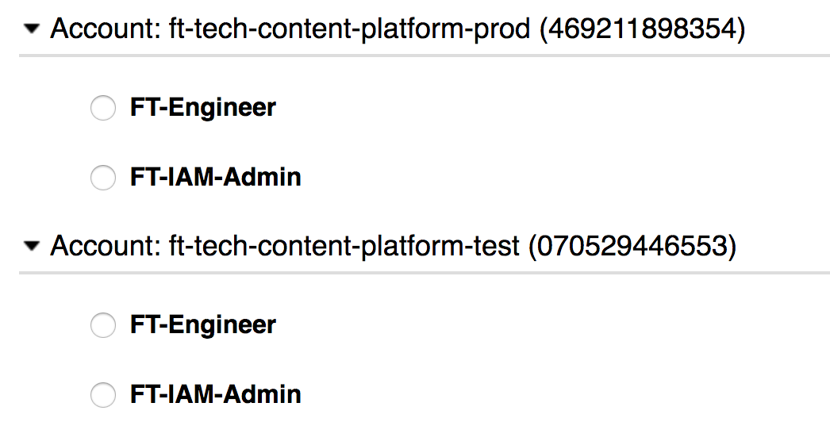
Notes:
we wanted to restrict permissions on what users can do with resources on the AWS accounts that they were allowed to login to using roles.
As you can see, we have two roles a user can assume. The FT-Engineer and the FT-IAM-Admin role.
By default all users who have access to login to an AWS account would be able to assue the FT-Engineer role. This still gives one the power to create and change most things in AWS
but if one were to make potentially risky changes to security policies and networking, we only allow named users and those users should be AWS certified.
By doing so, we managed to restrict access to data and resources in our aWS accounts.

Slide 25
Identify critical resources
Notes:
Now that we secured access to our accounts and resources, we wanted to identify the critical resources which is of security concern and costing us money and figured out they were EC2, S3 and IAM.

Slide 26
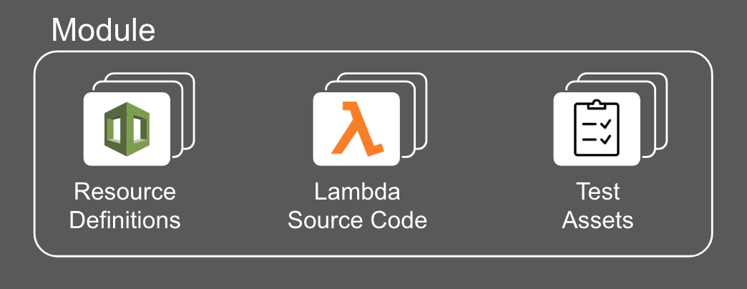
Reusable modules for Infrastructure
Notes:
And then we realized, back when we had one account, it was really hard for us to manually go through all the resources and see if they were compliant. Now we have more than 50 accounts and it is going to be even harder if we were to do things manually.
If we want to police things across 50+ accounts, it need to be done fairly, consistently and with less manual intervention. So we wrote module and called it composer which was deployed across all the AWS accounts that does compliance.
Composer modules are made of resource definitions, which is the desired configuration of an AWS resource, a lambda job, written in python which checks the current configuration of a resource against the desired configuration and sends it to AWS config

Slide 27
AWS Config
Notes:
So what is AWS config for those of you who dont know.
Config is a service offered by AWS which evaluates the configuration of the AWS resources.
It is used to automate the evaluation of recorded configurations against desired configurations of our AWS resources and report on it.

Slide 28
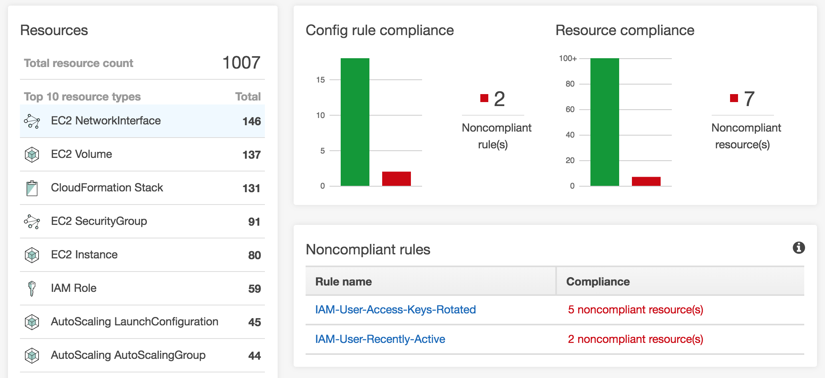
Notes:
This is how an AWS config dashboard looks like.
In AWS Config, you define rules for every configuration you want to check.
As you can see, it says we have 7 AWS resources that does not comply with our desired configuration rule for that resource.

Slide 29
Identity Access
Management
Notes:
Lets take IAM as an example. Identity Access management, also affectionately referred to as IAM, is used for controlling users access to AWS resources.

Slide 30
Wildcards in IAM policies.
Oh noes!
Notes:
When we had one large aws account, we have more than 300 IAM users and some of them had wildcards in the policies attached to them. Policies with wildcards in them can be very destructive. The resources running our website, membership and content platform were all in the large account. So it was a major security concern. we lost our production clusters once, We didn’t really want to do it again

Slide 31
IAM with flexibility & trust in mind. Yay!
Notes:
After moving to smaller accounts, we gave IAM admin privileges to a few named users who were AWS certified. We empowered the team to do what they want to do as the blast radius for a security breach was minimized. But unfortunately wildcards in policies were still a thing.

Slide 32
Notes:
So we implemented AWS config rules to define the restrictions on IAM policies and users.
I am not going to go through all of them. If you are interested to know more about the policies we have, please feel free to come and have a chat with me after this talk.
I am going to talk about a few of my favourite ones
https://cloudenablement.in.ft.com/aws/governance/iam_policy_rules/

Slide 33
Ermm....
Mercilessly deactivate a key after 180 days
Notes:
We encourage frequent rotation of AWS access keys.
We have a config rule which flags Keys older than 90 days
We have a service which deactivates keys older than 180 days but with sufficient warning (move to next slide)

Slide 34
But they were warned :)
Notes:
We do give the team fair warning before deactivating the access key. This is an example of an email that gets sent to the team when a key is closer to expiry.

Slide 35
Identify policies with wildcards
Notes:
My next favourite, wildcards!
We implemented AWS config rules to flag IAM policies that has elevated permissions on critical resources.VPC for example
By elevated, I mean s3 action * on resource * which can be quite destructive because you are giving permission to do things on all the S3 buckets in that account
That brings us to the next resource

Slide 36
S3 bucket is public.
Oops!
Notes:
S3.
A specific public S3 bucket is possibly at a risk of exposing personal and sensitive information to the public.
So we implements an config rule to check if the buckets in an account are public and report on it. The main reason behind this rule was GDPR.
So what happens if a S3 bucket is public?

Slide 37
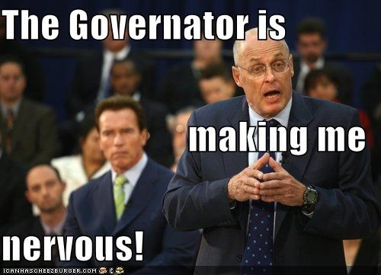
Behold the Governator
Notes:
We wrote a service and called it the Governaton.
It quarantines S3 buckets if it is public and terminates EC2 instances if the EC2 instance doesn’t comply with certain standards which I’ll be talking about later.
Ask AG how/where it runs
Explain how the governator works
https://cloudenablement.in.ft.com/aws/governance/ec2_policy_rules/
So what happens if an S3 bucket is public?

Slide 38
The mysterious case of unaccessible S3 buckets!
Notes:
If a S3 bucket is public and doesn’t have any bucket policies set to restrict the access of data within the S3 bucket, governator, a service we implemented, applies a bucket policy that restricts to only those able to login to the console, so as to manage the ACL’s and the bucket policies. This happens within a 24 hour window of the mis-configured bucket.
https://cloudenablement.in.ft.com/aws/governance/tagging_policy_rules/

Slide 39
Notes:
We notify the team about quarantining the S3 bucket. Once they have fixed permissions on the S3 bucket,

Slide 40
Notes:
We send them a job well done email :)
These are very few things that we do to secure our resources. Now I am going to talk about our second concern; saving money!

Slide 41
Costs
Notes:
saving money!
The first service that would spring to ones mind would be Ec2

Slide 42
Notes:
EC2! because they are very expensive
It costed us a lot of money and we had no way to find out which team owned what and made cost attribution difficult.
So we encouraged teams to tag their EC2 instances with their team emailt. If they didn’t,

Slide 43
Behold the Governator
Notes:
in came the governator, threatening to terminate the EC2 instances.
Explain how it works

Slide 44
Notes:
We give teams 2 hours before Governator terminates the instances. We send a notification to the email address attached to the AWS account in which the instance is running in, with information about why the EC2 instance is scheduled for termination. We did this because we wanted clearer ownership for better cost attribution
We also realized we can save more monies by

Slide 45
Migrate instance from RHEL to Amazon Linux/ CoreOS
Notes:
Moving away from RHEL.
So we implemented AWS config rules to:
Flag instances running on RHEL
We encouraged teams to move from RHEL to Amazon Linux or CoreOS if using containers
We approximated the savings to be 500 dollars for every server that was migrated in terms or license and usage.

Slide 46
Always use current generation instance type
Notes:
Flag instances running on old generation instance type like T1, M1, M2, M3, C1 and R3.
We encouraged teams to migrate to current generation instances to save money and benefit from higher performance hardware.
Last week we migrated 30 servers from m3.large to m5.large. The savings were approximated to be 27 dollars per instance.
We saved 810 dollars! This doesn’t sound like a lot, but, this all adds up every month

Slide 47
Unattached EBS volumes eats money
Notes:
Flag EBS volumes that are no longer attached to an EC2 instance and notified the team.

Slide 48
Abandoned ELB’s/ ALB’s
Notes:
Flag Elastic Load balancers and application load balancers which did not have any registered instances.
By deleting unused ELB’s and ALB’s we approximated the savings to be 240 dollars per load balancer per year
So these are a few rules we have in place to save us some monies.

Slide 49
Turn off EC2 instances
Notes:
We also encouraged teams to turn off EC2 instances, only non-production servers overnight and at weekends when the teams are not working. EC2 is an on-demand service. You only pay for server instances whilst they are running. We wrote a service to make it easier for the delivery teams to turn off instances.

Slide 50
EC2 powercycle
Notes:
And we called is EC2 powercycle.
It is a Lambda function that looks for EC2 instances and Auto Scaling Groups that has a resource tag of ec2Powewrcycle.
The Tag value is a simple JSON document that describes start and stop schedule in crontab-like expressions.
For auto scaling groups, you’d have to specify the scaling state of the group - the minimum and the desired instances in the group
If they are, the min and the desired is defaulted to 1
But turning off instances, we saved about 70% of the cost.
So these are a few changes we did to save us some monies.

Slide 51
Cost attribution
Notes:
And then we thought, it should not be the centralized team who creates these config rules responsibility to try and alert the delivery teams about the changes that they need to make to their resources to make it compliant.
we thought it would be great to create awareness about the amount of money a delivery team is spending on AWS resources. To do so, we need to find a way to relate a system to a service and a service to a team

Slide 52
Attribute resources to teams
Notes:
So we introduced a system identifier called systemCode which we use to identify a system at the FT
Our definition of system was:
A business or a technical service
An application
Infrastructure components. For example databases, load balancers, virtual servers
The system identifier were linked to a team.
And teams were encouraged to tag their resources with the correct team email group and systemCode.
So what am i trying to say?

Slide 53
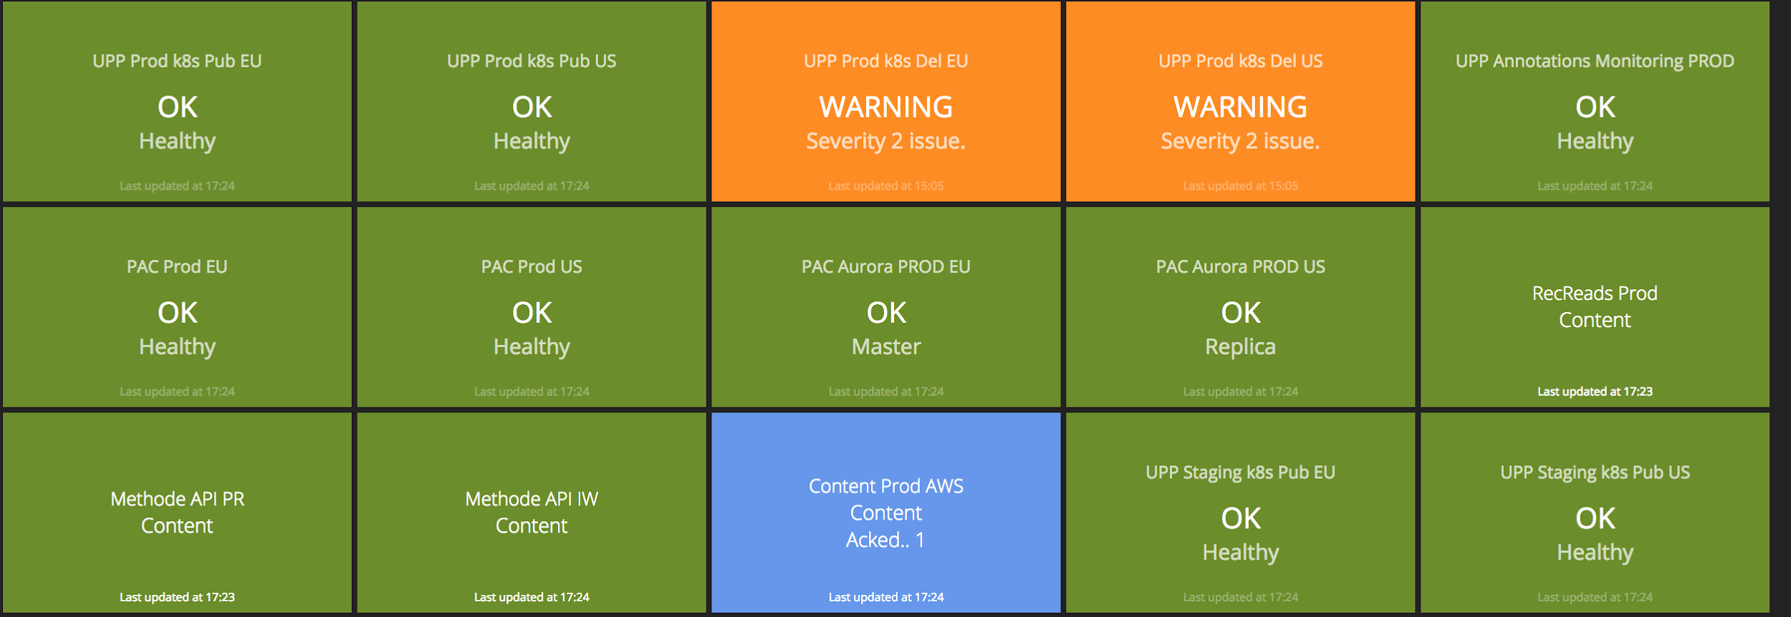
Notes:
Lets take an example
This is dashing. It is our monitoring tool. It was developed by Shopify

Slide 54
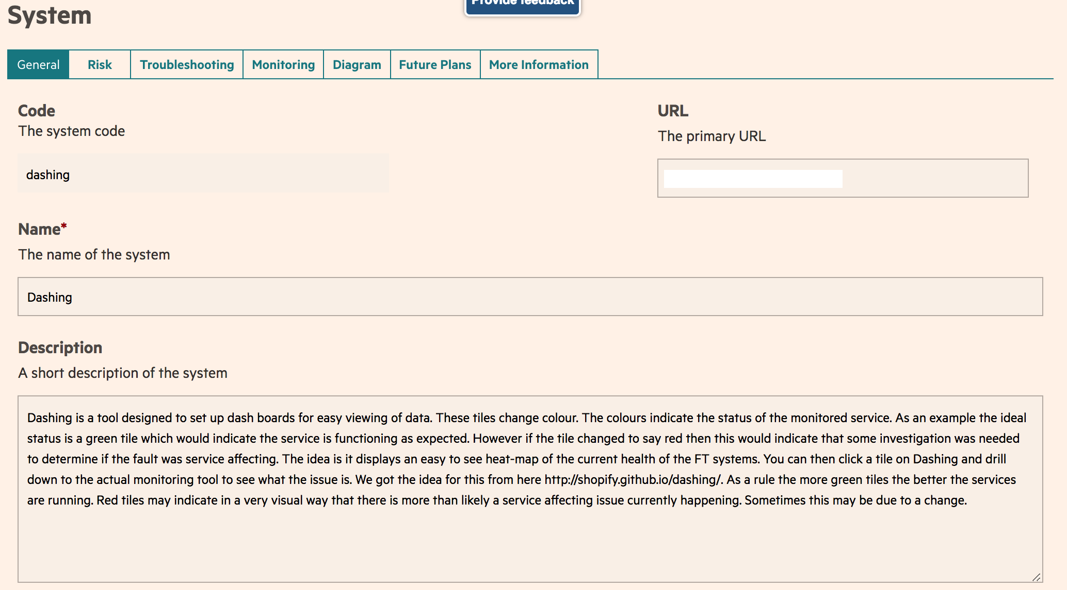
Notes:
This is the system definition of dashing
As you can see, it is given a systemCode of dashing, which is the system identifier.
Teams will have to tag the instances on which dashing is running on with the systemCode of dashing

Slide 55
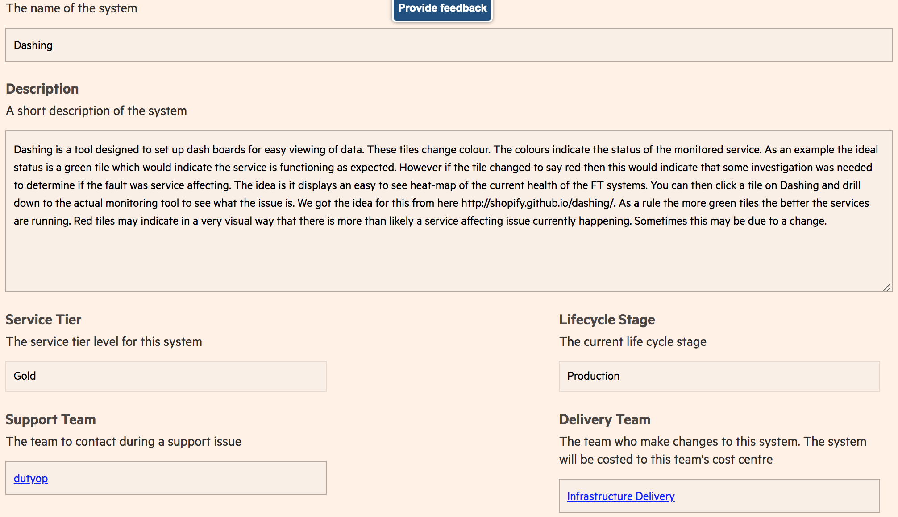
Notes:
We also specify the team who is responsible for looking after dashing. In this case it is the infrastructure delivery team.
So the cost of running dashing will be attributed to the Infrastructure delivery team.
Now that we have a way of figuring out who owned what, we created pretty visualization of how much a team is spending.

Slide 56
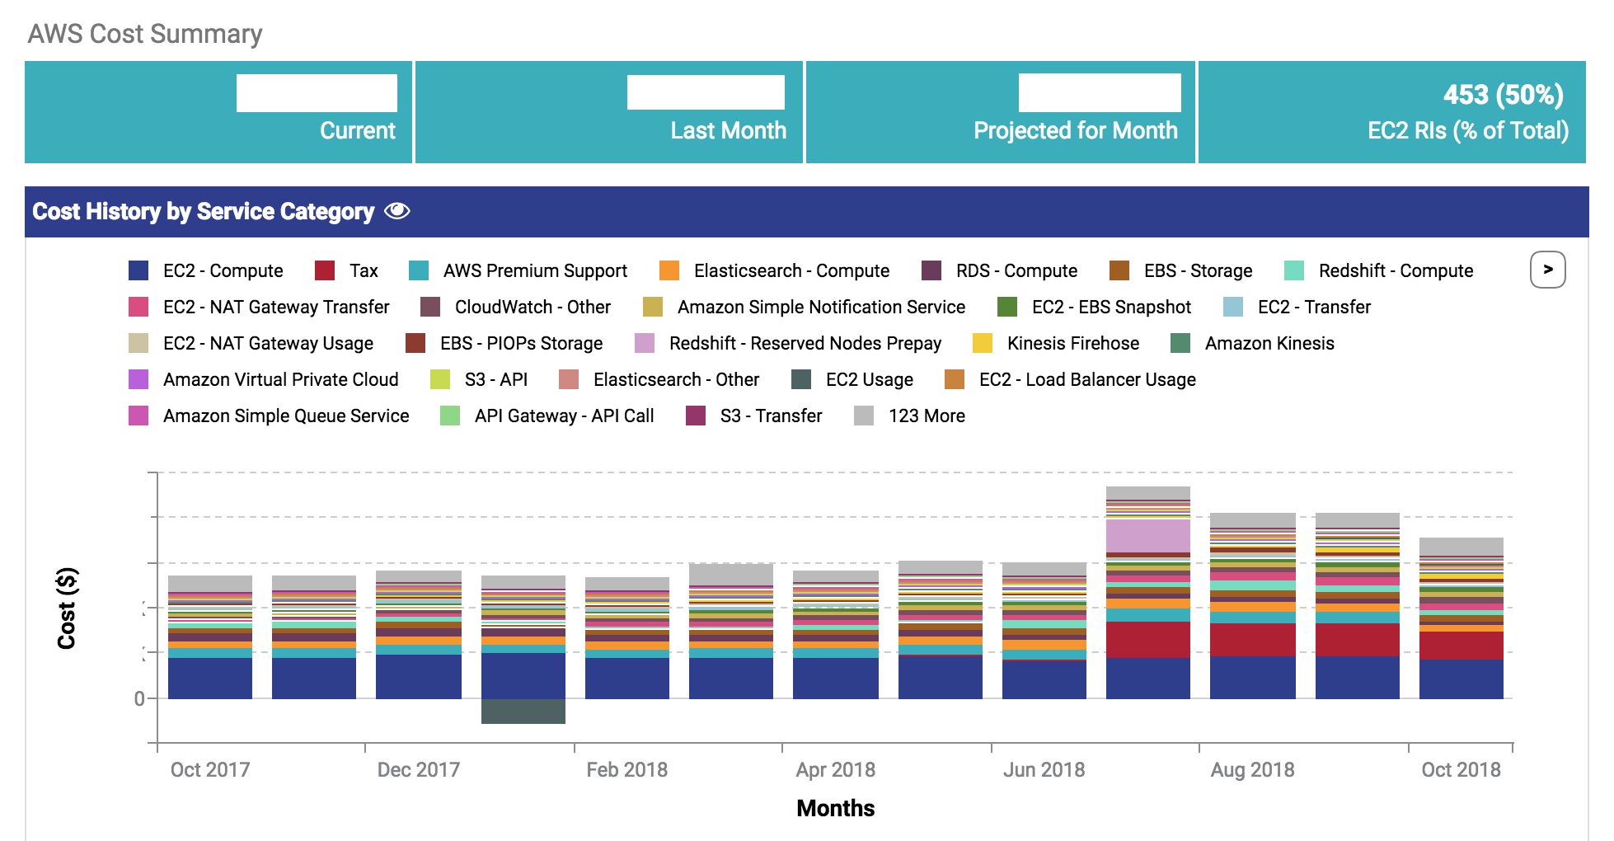
Notes:
Everybody likes a pretty colourful graph.
This is cloudhealth. You can filter AWS expenditure and usage based on team and systemCode.
You can also generate reports on expenditure and get it delivered to your mailbox first thing on a monday morning :)
But the downside of Cloudhealth is that it requires you to have an account. It will be hard for everyone at the FT to get an account. So we created an internal tool called

Slide 57
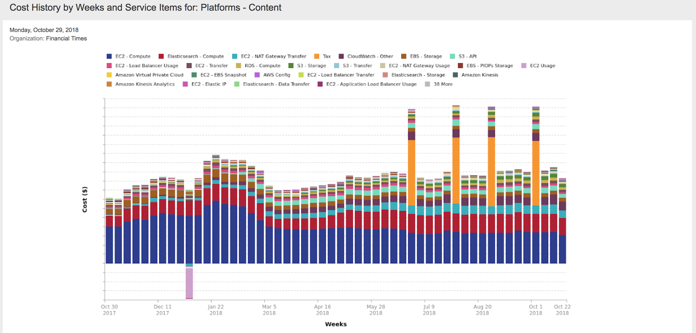
Notes:
Everybody likes a pretty colourful graph.
This is cloudhealth. You can filter AWS expenditure and usage based on team and systemCode.
You can also generate reports on expenditure and get it delivered to your mailbox first thing on a monday morning :)
But the downside of Cloudhealth is that it requires you to have an account. It will be hard for everyone at the FT to get an account. So we created an internal tool called

Slide 58
Notes:
Smart Cloud use.
This is a dashboard for a team.
The dashboard summarizes the AWS cost incurred by a team.

Slide 59
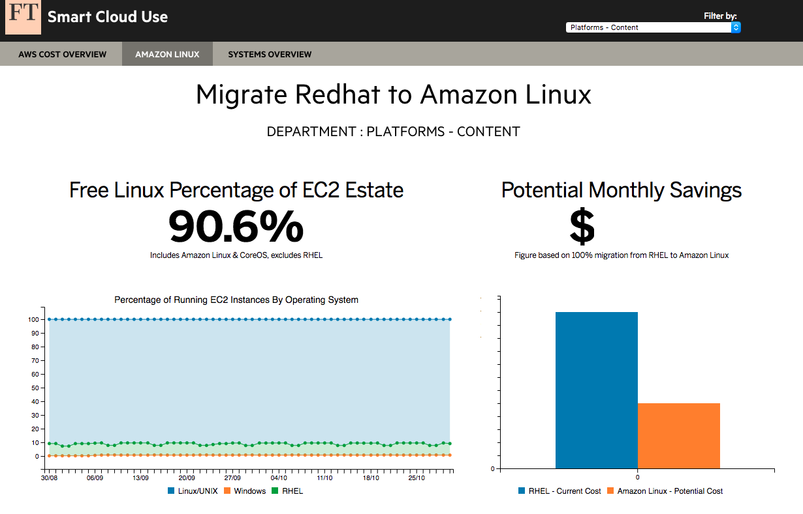
Notes:
It also tells you the status of a teams EC2 estate and tells you how much the team can save if they migrate from RHEL to Amazon linux.
So this is how we created awareness about the costs by a delivery team.
So we are nearly at the end and

Slide 60
Empower & get out of their way
Nudge Theory - https://www.youtube.com/watch?v=RKt51m1znAo by Sarah Wells
Notes:
Just to summarize, FT took the nudge theory approach with regards to governance.
There is a really nice talk about Nudge theory by Sarah Wells, who is the Technical Director of Operations & Reliability at the Financial Times.
For those who do not know what nudge is, Nudge is a concept in behavioral science, political theory and economics which proposes indirect suggestions as ways to influence the behavior and decision making of groups or individuals
And us at the FT are huge believers in empowering our team to make the right technological decisions to suit their needs because an empowered team is a happy and productive team.

Slide 61
But govern at the same time :)
Nudge Theory - https://www.youtube.com/watch?v=RKt51m1znAo by Sarah Wells
Notes:
but we also introduced subtle policy changes to encourage them to make the best decision with security and cost in mind when designing their infrastructure.

Slide 62
@JermilaD
jermila.dhas@ft.com
We're hiring!
https://ft.com/dev/null

